Slide 1
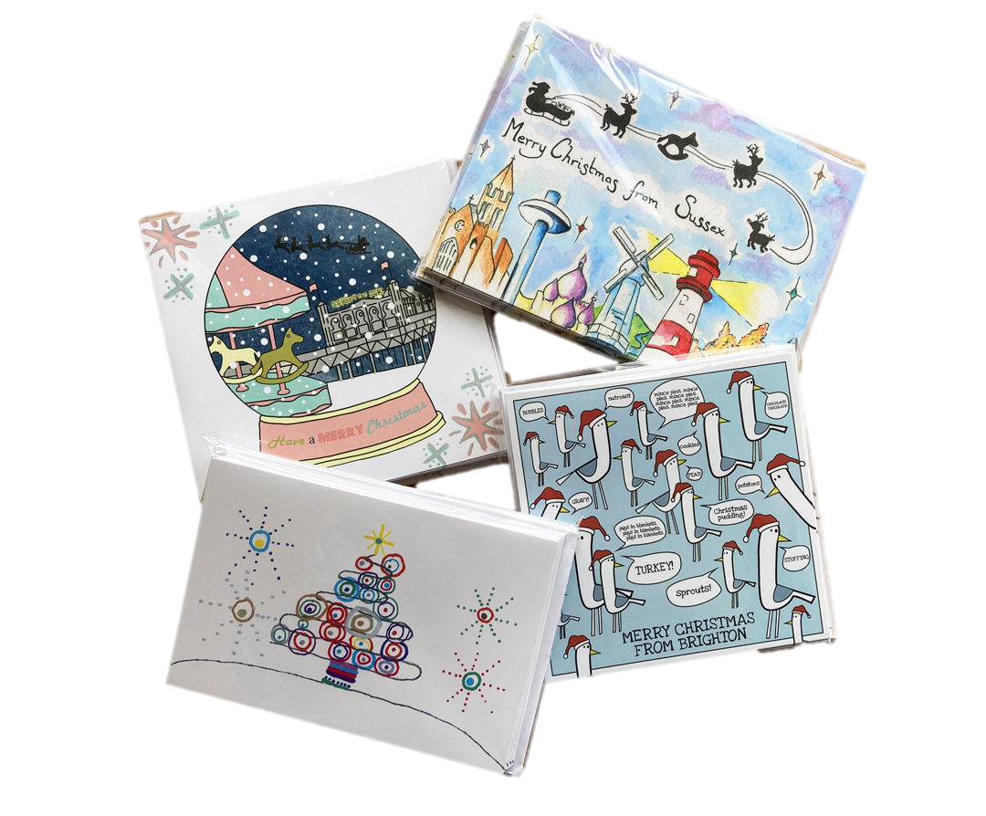
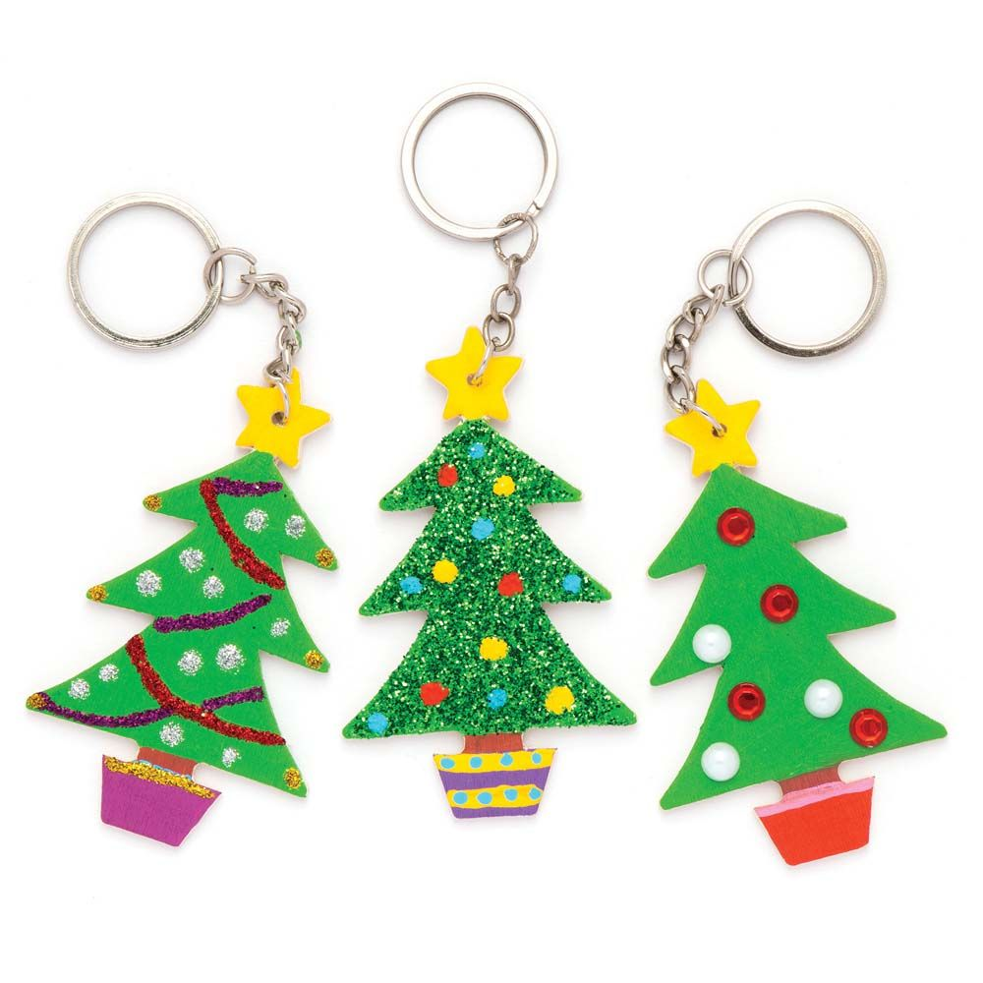
Student Enterprise
CHRISTMAS GIFTS

Slide 2
Welcome to Student Enterprise
During this session
You are not a student
You are a business person or employee
This is not a classroom
It is a Office or Boardroom

Slide 3
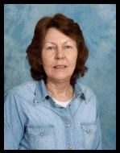
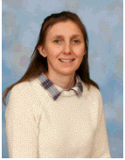
Our FE Business
Katie
Business Director
Lucy
Head of Promotions
Jeff
Head of Production
Mel
Employability
Heloise
Princes Trust
Jenny
Manufacturing - Horticulture
Kevin
Manufacturing -DT
Vanessa
Manufacturing - Art

Slide 4
Today’s Plan
Product Development

Slide 5
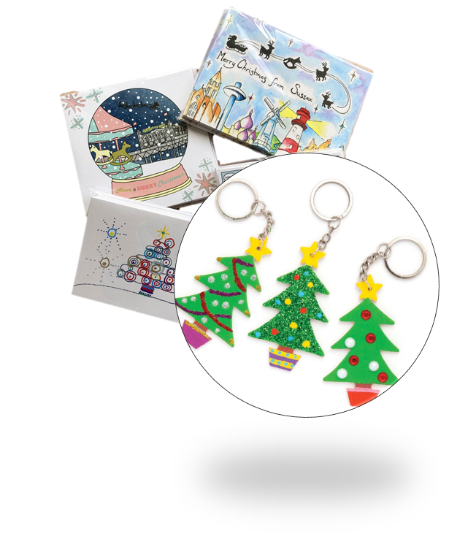
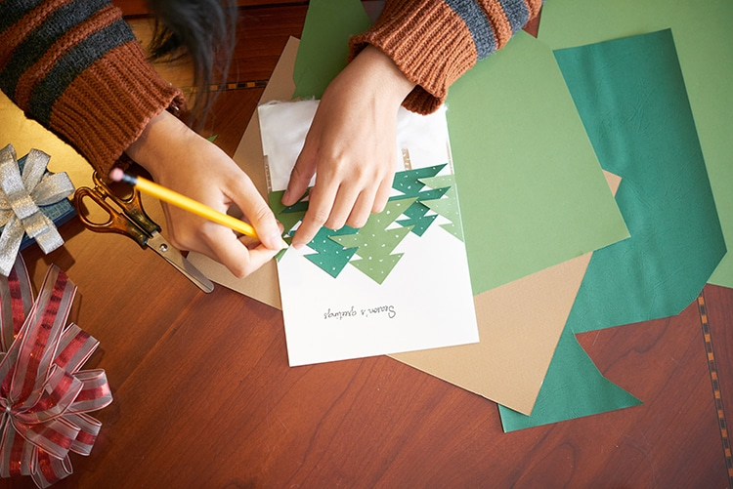
OUTCOMES
Design a Christmas gift
Complete market research
Make Christmas gifts

Slide 7
Design a Christmas gift

Slide 8
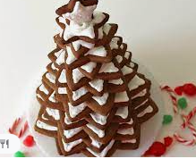
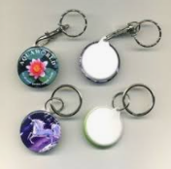
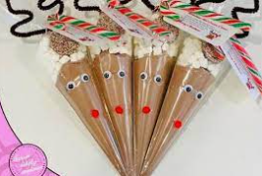
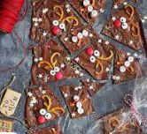
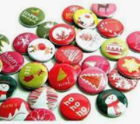
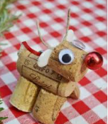
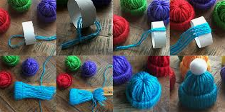
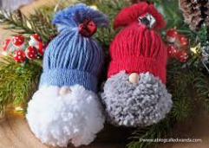
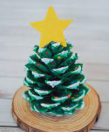
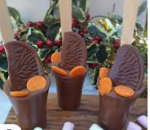
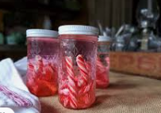
IDEAS
Gingerbread Xmas tree
Design a Christmas gift
Badges
Hot chocolate cones
& Keyrings
Reindeer chocolate
Cork Reindeer
Chocolate orange stirrers
Candy cane Vodka
(18+)
Woolly hats
Cone Christmas tree

Slide 9
PLANNING
Design a Christmas gift
1.What do we need?
2.Where can we get it from?
3.When do we need it?

Slide 10
Market Research

Slide 11
What do we ask?
Who do we ask?

Slide 12
What skills have you used?

Slide 13
Making Gifts

Slide 14
Today’s Plan
Product making

Slide 16
Tidying up

Slide 17
What skills have you used?

Slide 18
Promoting Gifts

Slide 19
Welcome to Student Enterprise
During this session
You are not a student
You are a business person or employee
This is not a classroom
It is a Office or Boardroom

Slide 20
Today’s Plan
Promoting Products

Slide 21
OUTCOMES
Talk about our Christmas gift
Learn about promotions
Sell + Promote Christmas gifts

Slide 23
How do we promote?

Slide 24
IDEAS
Posters
Flyers
Social media

Slide 25
Today’s Plan
Selling

Slide 27
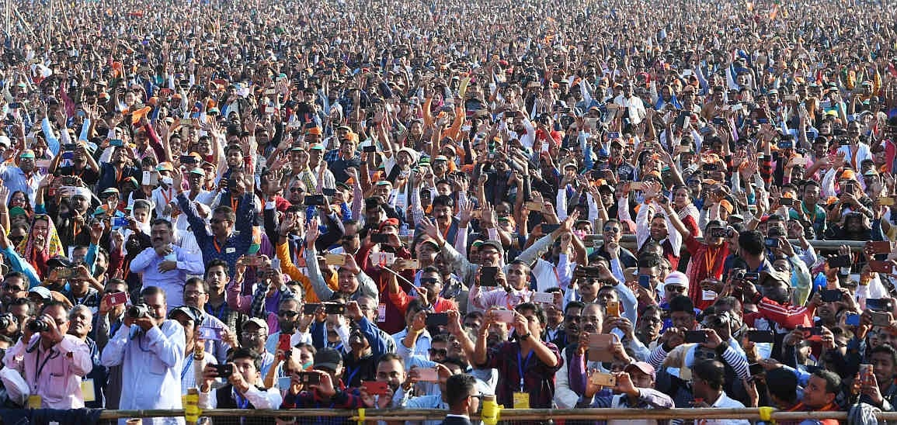
Who can we sell to?

Slide 28
What skills have you used?

