Slide 1
Employability & Living Skills Group
Student Name
DAY | 8.45am | 9.15 | 9.55 | 10.45 | 11.00 | 11.40 | 12.25pm | 1.30pm | 1.35 | 2.15 | 3.00pm
Community visit
English
Transition
with Mr Court
Bewbush Community Centre
Maths
On site Work Experience
Cafe or Shop
Digital
Skills
Student Enterprise Projects
Carousel
Creative Arts Choice
ART
FE Social Time

Slide 2
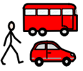
Preparation for Independence Group
Student Name
DAY | Start | Lesson 1 | Lesson 2 | Break | Lesson 3 | Lesson 4 | Lunch |  | Lesson 5 | Lesson 6 | End
Animation
Cooking
Digital Skills
Mindfulness
RSHE
Community visit
Creative Arts
FE Social Time

Slide 3
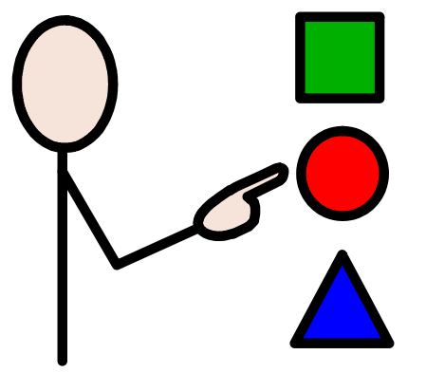
Skills for Life Group
StudentName
DAY | Start | Lesson 1 | Lesson 2 | Break | Lesson 3 | Lesson 4 | Lunch |  | Lesson 5 | Lesson 6 | End
Community visit
RSHE
Therapies
+ wellbeing
Cooking
Mindfulness
Mindfulness
Carousel
Creative Arts Choice
FE Social Time

