Slide 1
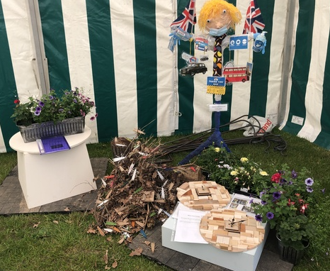
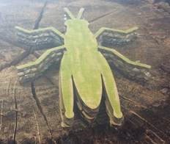
Jim Green Challenge 2022

Slide 2
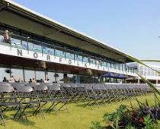
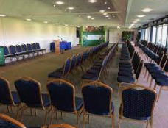
Wednesday 16th March 2022
The Norfolk Pavilion – South of England Showground

Slide 3
Make a sculpture of a tree
75% of materials used must be recycled
Maximum of 1 metre square

Slide 4
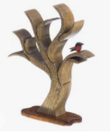
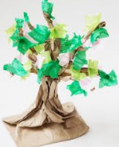
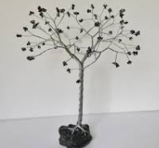
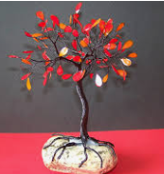
Make a sculpture of a tree
No diary required

Slide 5
Make a model depicting
‘The Forest’
To be displayed flat – no bigger than A1
Balanced composition – Mix of textures

Slide 6
Make a model depicting
‘The Forest’
Charcoal burners
Tree line
Logging with heavy horses
Suggested features
Foresters in
a wood
Evergreens
Deciduous trees
River floating
logs down
Logging
Trees growing on a mountain
Sawing

Slide 7
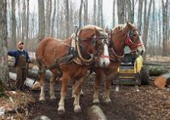
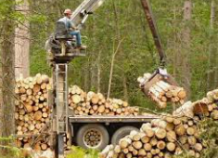
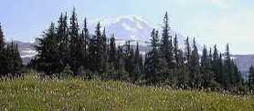
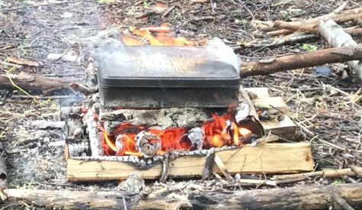
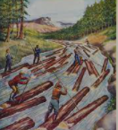
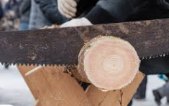
Make a model depicting
‘The Forest’

Slide 8
Lemon Drizzle Tray-bake kit
Made from a packet mix
Display on a plate – Ice and decorate

Slide 9
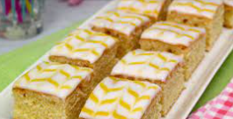
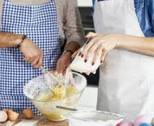
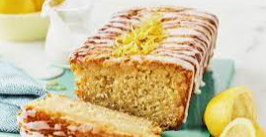
Lemon Drizzle Tray-bake kit

Slide 10
Spring Bulbs
Diary needed
Grow a variety of spring bulbs in a 12” container
NO
RE-POTTING
Make a diary to show the growth process

Slide 11
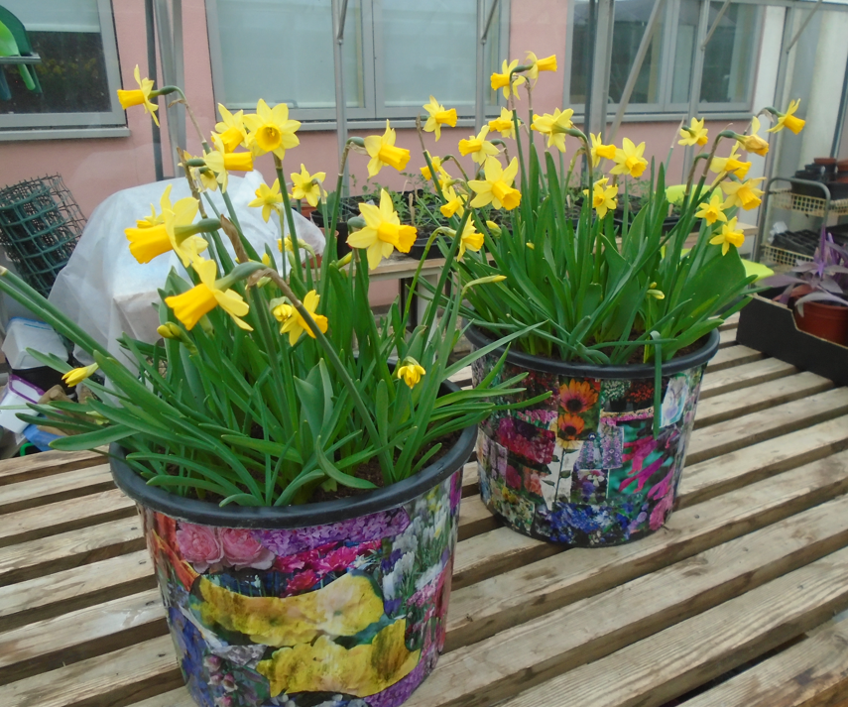
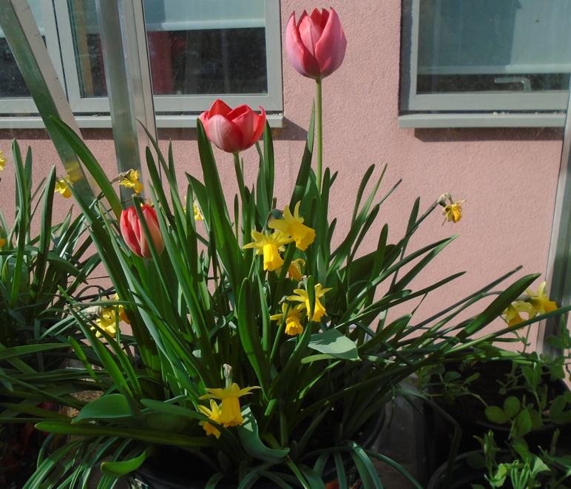
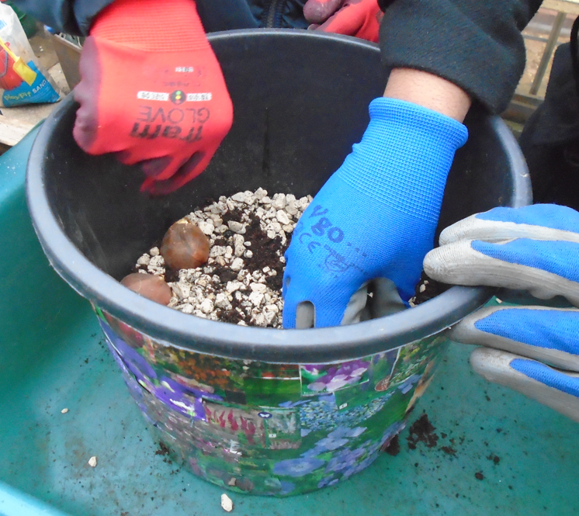
Spring Bulbs

Slide 12
Board game using hand tools
Portfolio of construction needed
To be made primarily from wood – any shape – no bigger than 40cms diameter
Can include components, maybe painted and decorated

Slide 13
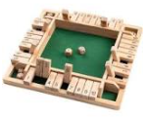
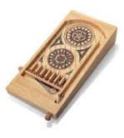
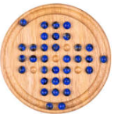
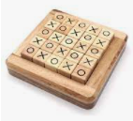
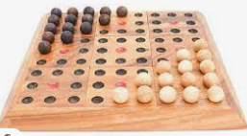
Board games

Slide 14
Self-supporting Scarecrow of a Pantomime character
Diary needed
Not to be bigger than 2 meters
Not to be wider than 1.5 meters
Two team members will be given 15 minutes to assemble on the day

Slide 15
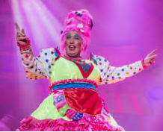
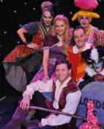
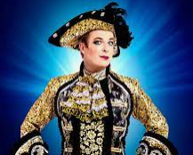
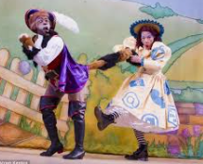
Self-supporting Scarecrow of a Pantomime character

Slide 16
On the day…
Task 1: Identification
Woodland theme

Slide 17
On the day…
Task 2: Prepare a follower bed
Judged on:
Tidy working
Spreading compost evenly
Team working
Leaving tools clean
Overall appearance
2 Team members
All equipment supplied

Slide 18
On the day…
Task 3: Window box
Judged on:
Enough soil
How plants are handled
Team work
Overall appearance
Watering
2 Team members
All equipment supplied

Slide 19
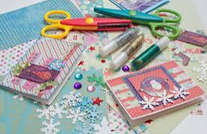
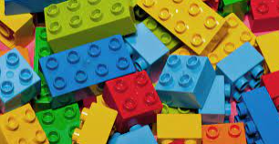
On the day…
Fun activities
Card making
LEGO

Slide 20
On the day…
Presentation 2pm
Tea & cake 2:30pm

