Slide 1
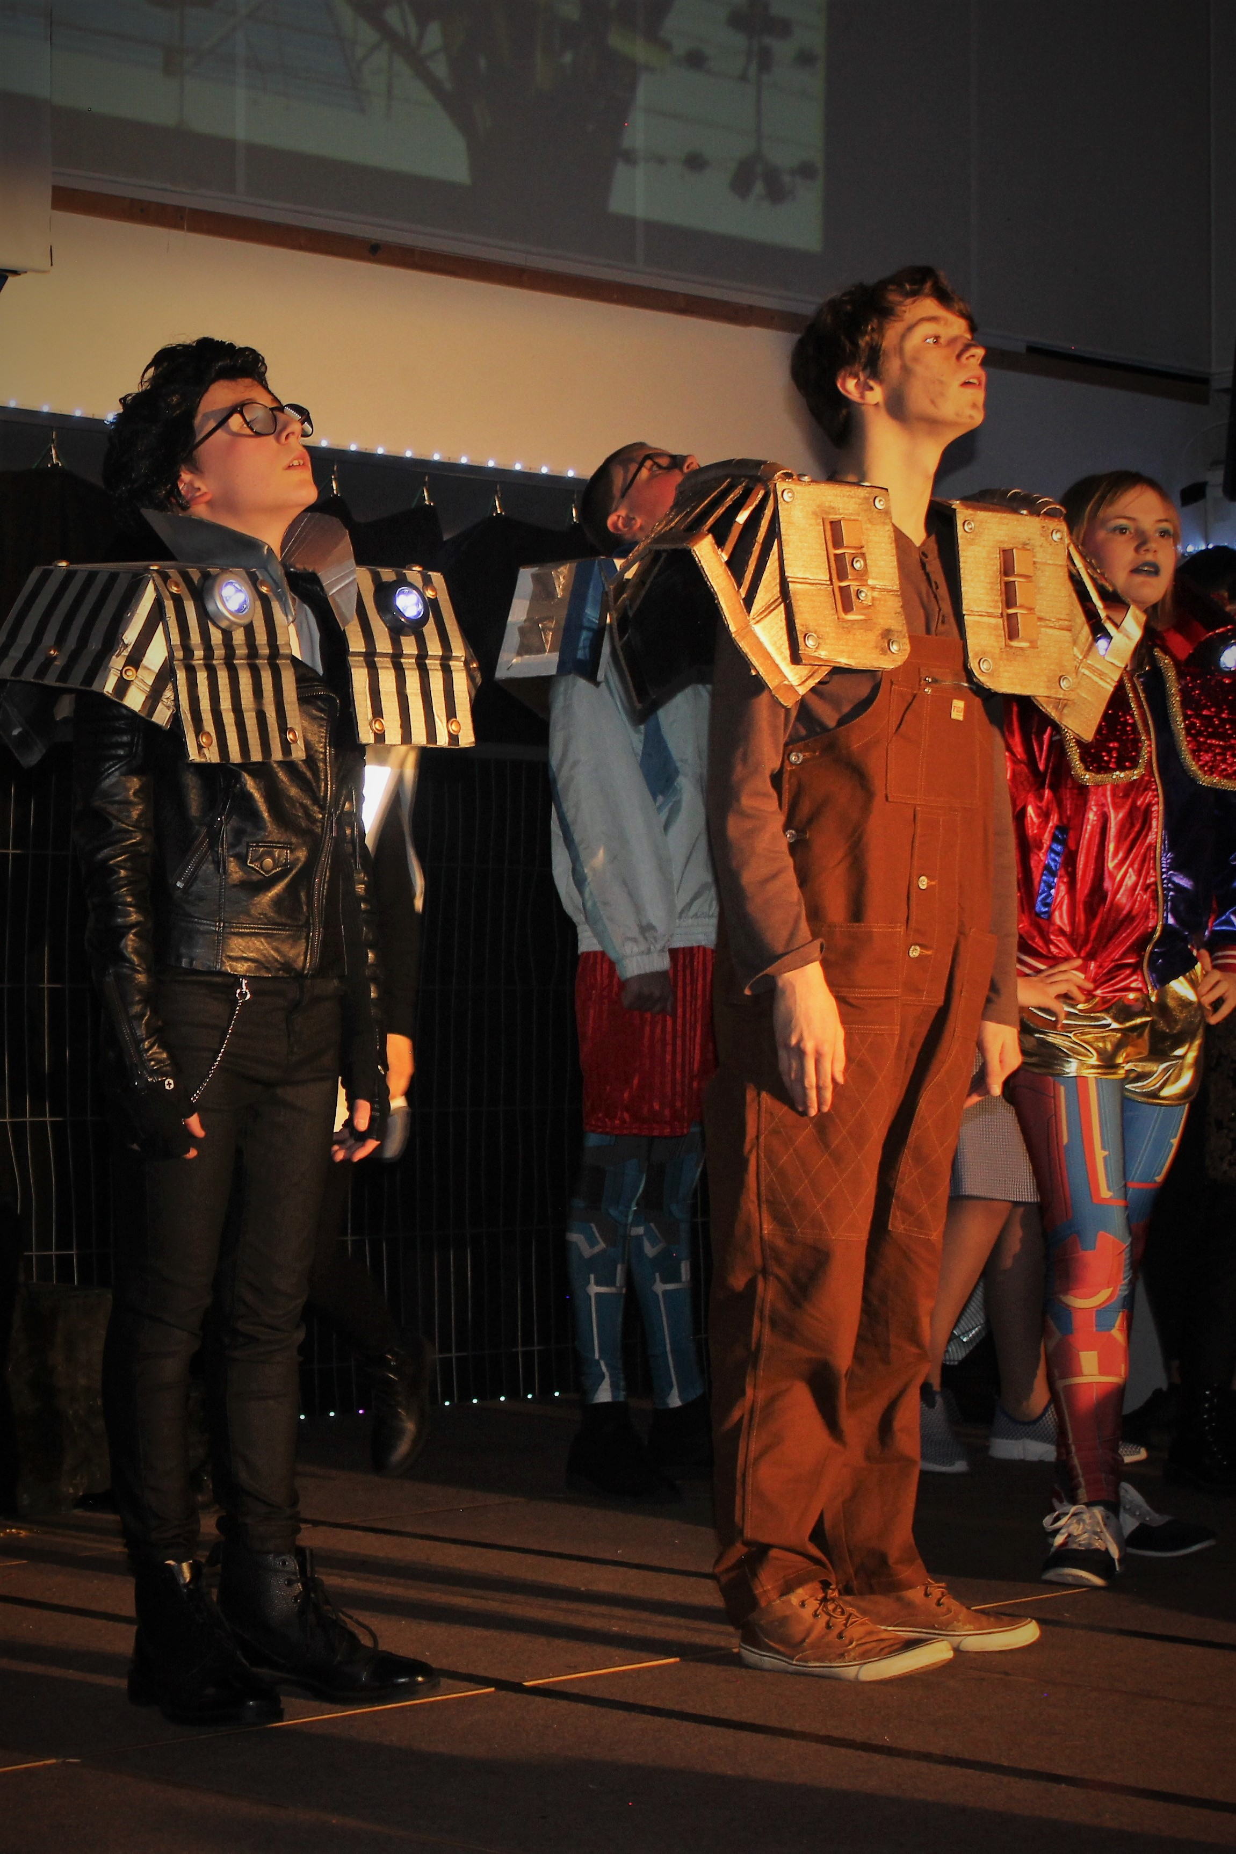
Manor Green College
New Parents Information Session

Slide 2
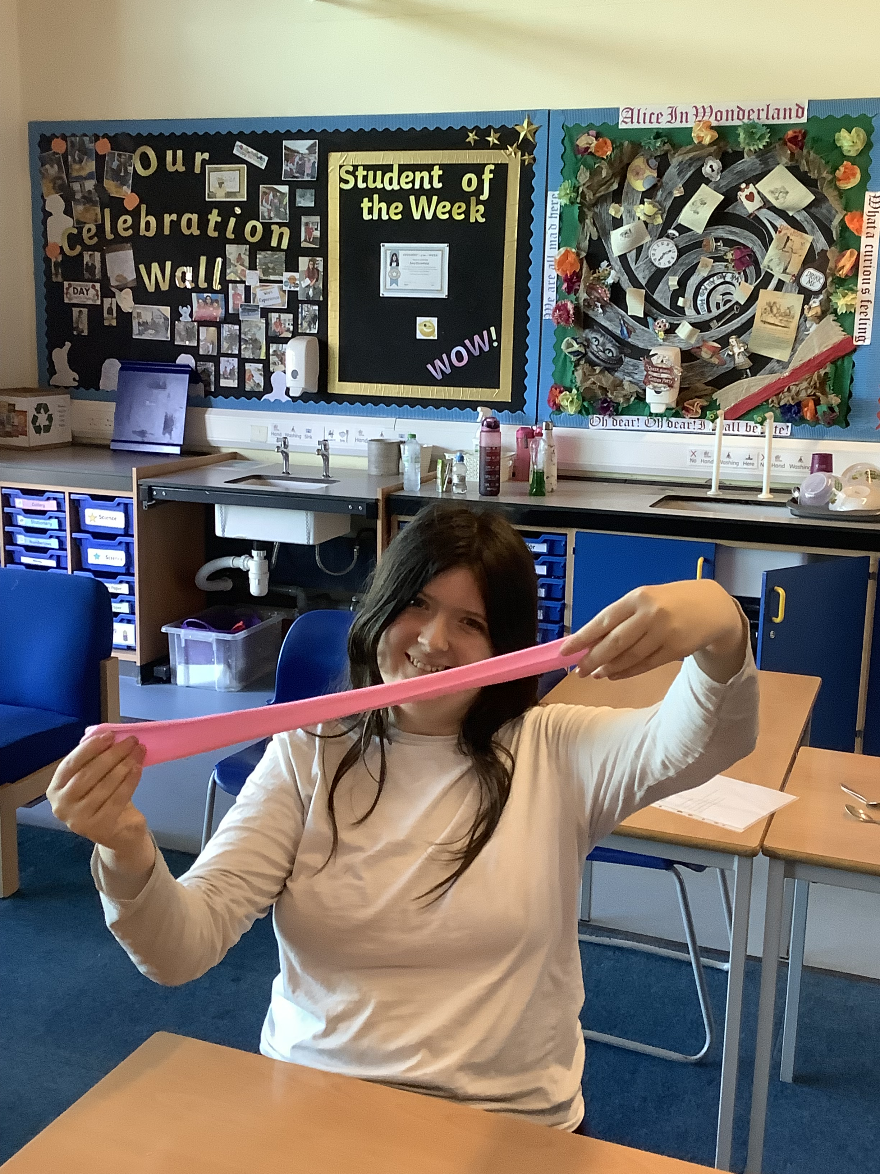
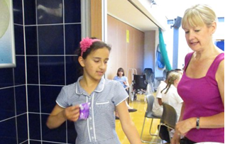
Vision
The core purpose of MGC is to discover and develop every student’s potential in preparation for their adult life, and our fundamental belief is that happy learners, learn better.
Independence
Learning
Social understanding

Slide 3
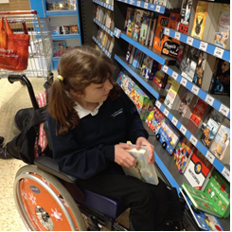
What can you expect from us….
A dedicated staff team
A safe environment for your child to develop
Communication
Enrichment
Learning tailored to your child’s individual needs
Support and preparation for their next steps

Slide 4
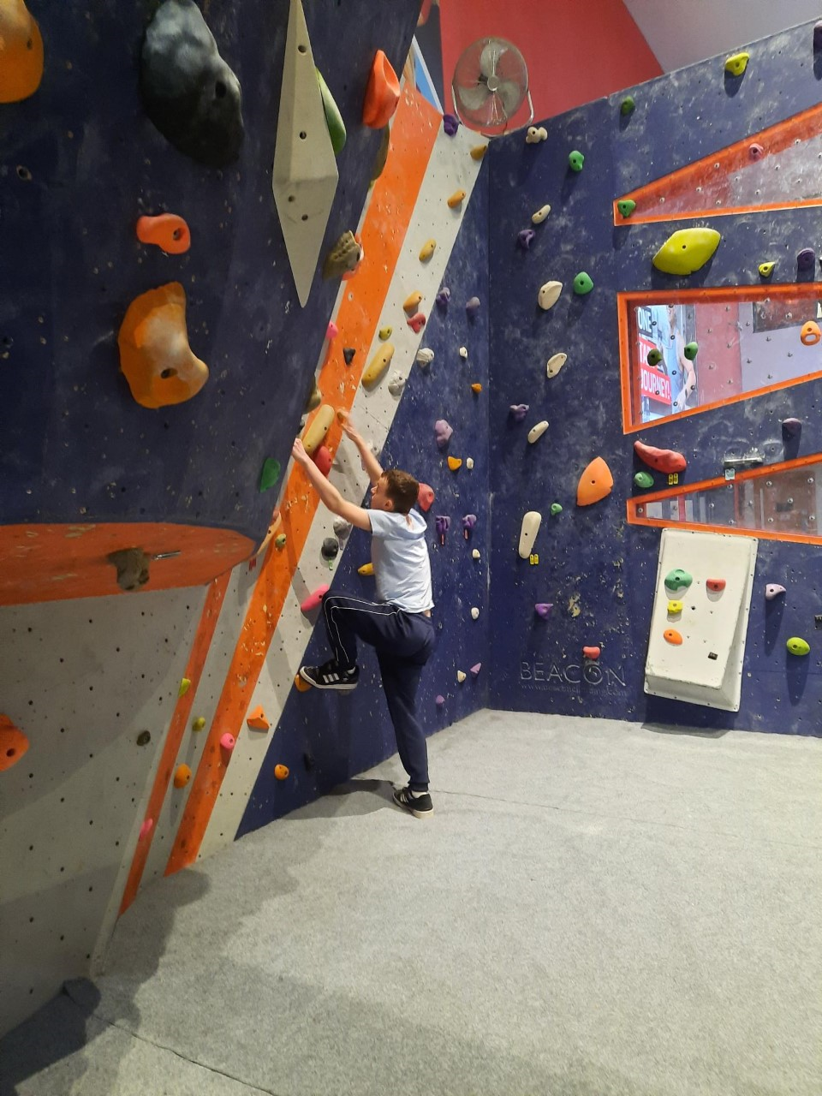
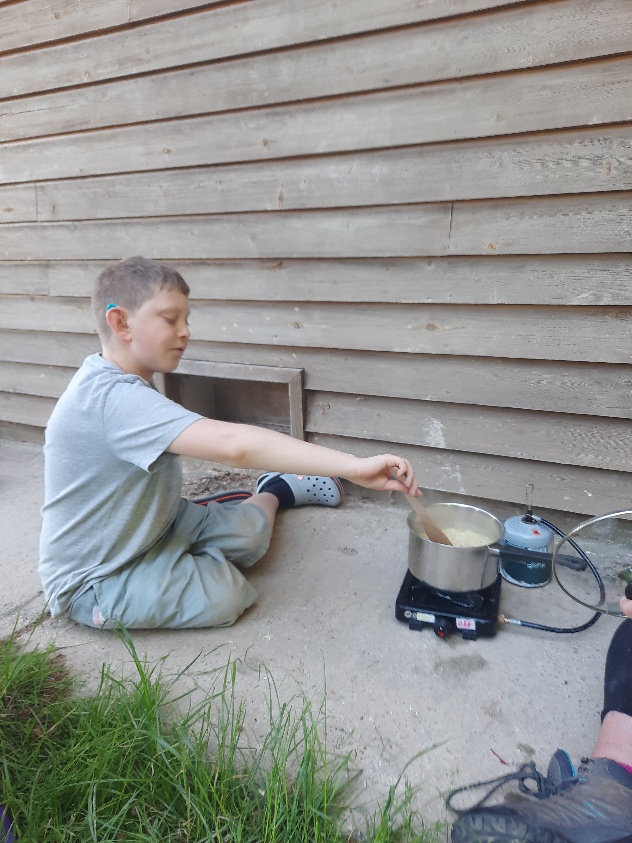
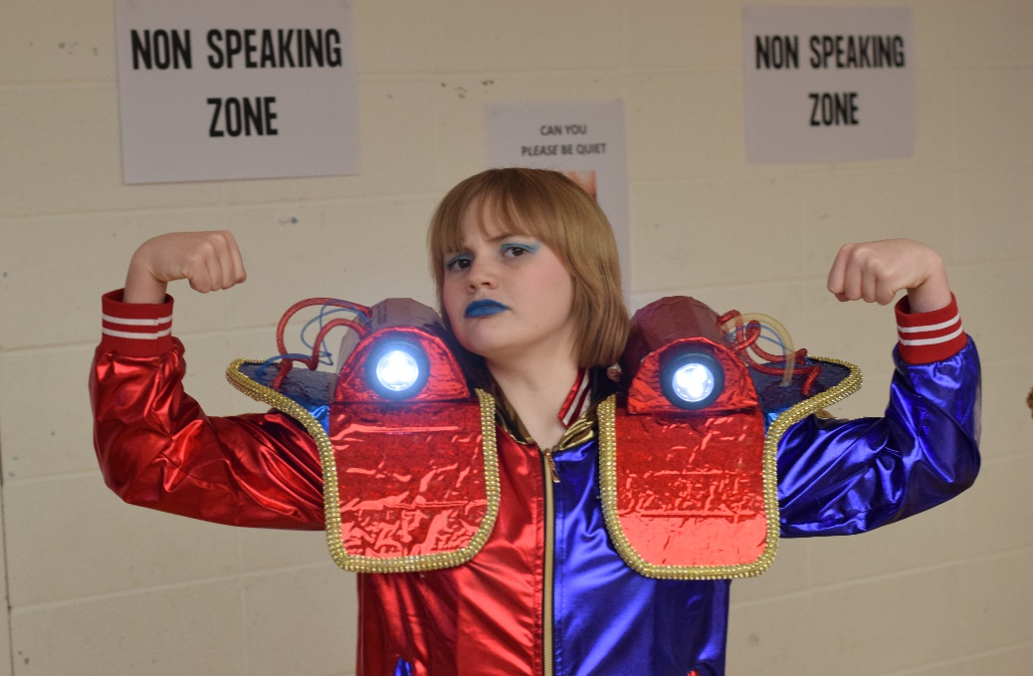
Curriculum
Class Teacher
Specialist Classes
Food Technology
Art
DT
PE
Forest Schools
Life Skills
Curriculum Maps on the college Website

Slide 5
Key Staff

Slide 7
MGC Pastoral Team

Slide 8
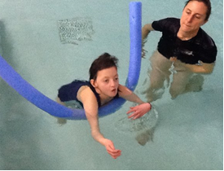
Start of Term
Following the summer break, we are having three Inset Days to allow for staff mandatory training and these are:
Friday 1st September
Monday 4th September
Tuesday 5th September
There will be a staggered return of students as follows:
Wednesday 6th September - YEAR 7 students and HIGH NEEDS CLASSES (3CA, 3CB, 3KL, 5SM) return to the College.
Thursday 7th September – ALL REMAINING STUDENTS return to the College.
Please see a reminder of the start and end of day arrangements:
8:45am Parents drop off
8:55 - 9:20am Transport drop off
2:45pm Early authorised parent collections
3:00pm Parent collections
3:10 - 3:40pm Transport collections​

Slide 9
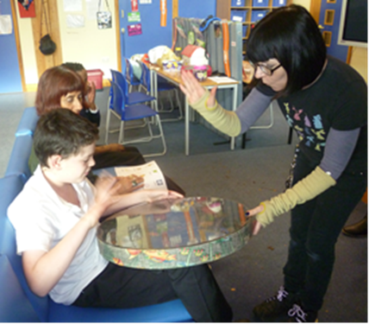
Communication
Class Dojo
Email
School gateway (We need you to sign up to this)
Phone calls
Class team
Key stage leaders
Partnership team
Pastoral Officer

Slide 10
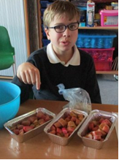
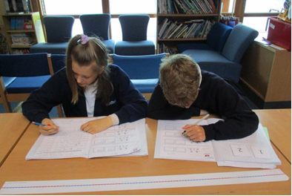
Monitoring progress
Annual Review
Parent Conversations
Earwig
Annual Progress Report
If you need to discuss your child please contact class teacher

Slide 11
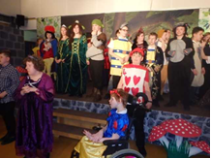
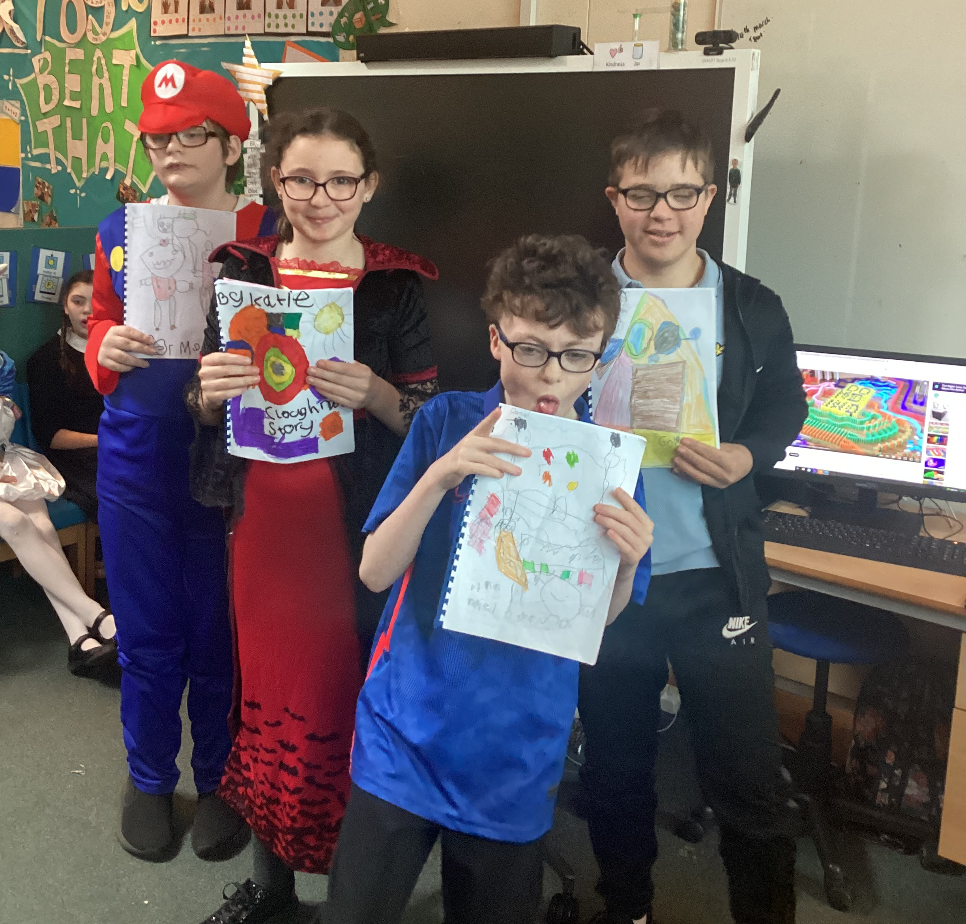
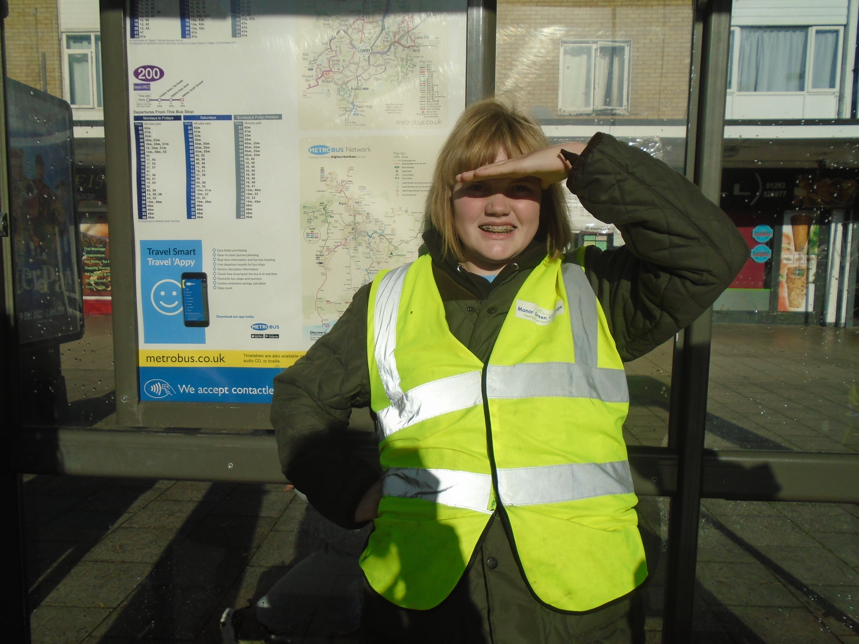
Enrichment
Activity days
Yoga
Crawley sings
Extra curricular clubs
Cricket club
Football
Music
Choir
Computer club
Swimming
External visitors
Life skills
Community visits
Arts club / Trips
Winter Lights
Enterprise activities
The list goes on……

Slide 12
Home College Partnership

