Slide 1
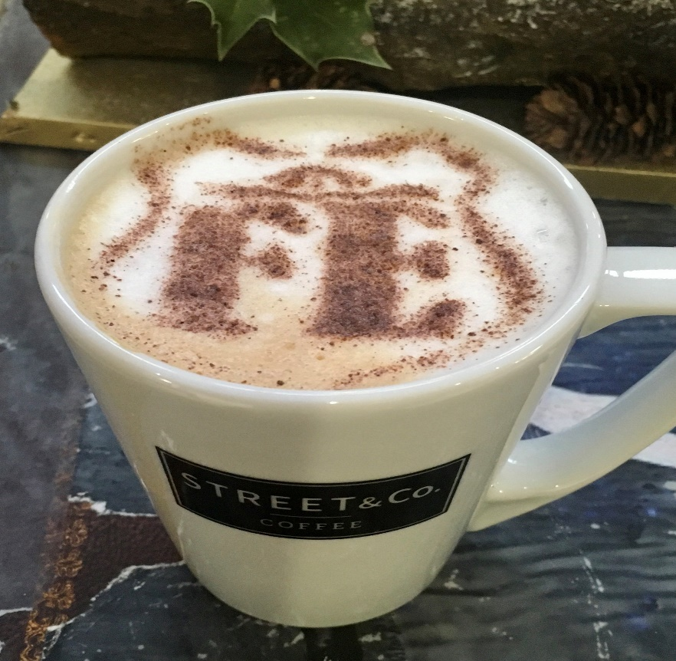
Student Enterprise
FE CAFÉ

Slide 2
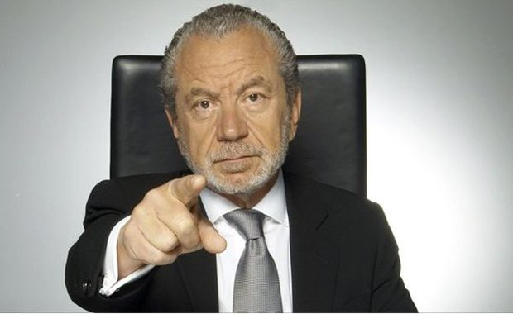
Welcome to Student Enterprise
During this session
You are not a student
You are a business person or employee
This is not a classroom
It is a Office or Boardroom

Slide 3
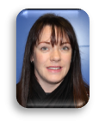
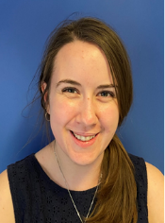
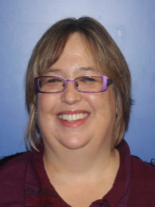
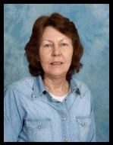
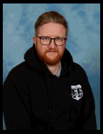
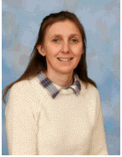
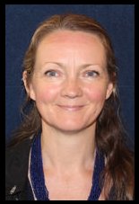
Our FE Business
Katie
Business Director
Lucy
Head of Promotions
Jeff
Head of Production
Mel
Employability
Heloise
Princes Trust
Jenny
Manufacturing - Horticulture
Kevin
Manufacturing -DT
Vanessa
Manufacturing - Art

Slide 4
Today’s Plan
Product Development

Slide 5
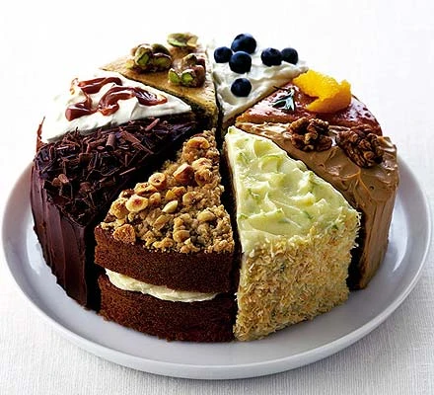
OUTCOMES
Design a Cafe treats
Complete market research
Make Café treats

Slide 7
Design a Café treat

Slide 8
IDEAS
Design a FE Café treat

Slide 9
PLANNING
1.What do we need?
2.Where can we get it from?
3.When do we need it?

Slide 10
Market Research

Slide 11
What do we ask?
Who do we ask?

Slide 12
What skills have you used?

Slide 13
Making treats

Slide 14
Today’s Plan
Product making

Slide 15
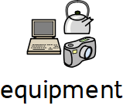

Slide 16
Tidying up

Slide 17
What skills have you used?

Slide 18
Product Promotion

Slide 19
Welcome to Student Enterprise
During this session
You are not a student
You are a business person or employee
This is not a classroom
It is a Office or Boardroom

Slide 20
Today’s Plan
Promoting Products

Slide 21
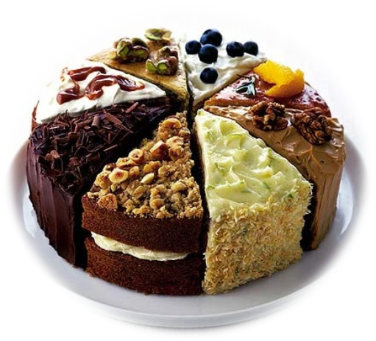
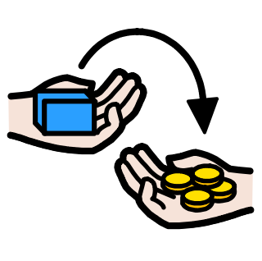
OUTCOMES
Talk about our FE Café treats
Learn about promotions
Sell + Promote FE Café treats

Slide 23
How do we promote?

Slide 24
IDEAS
Posters
Flyers
Social media

Slide 25
Today’s Plan
Selling

Slide 27
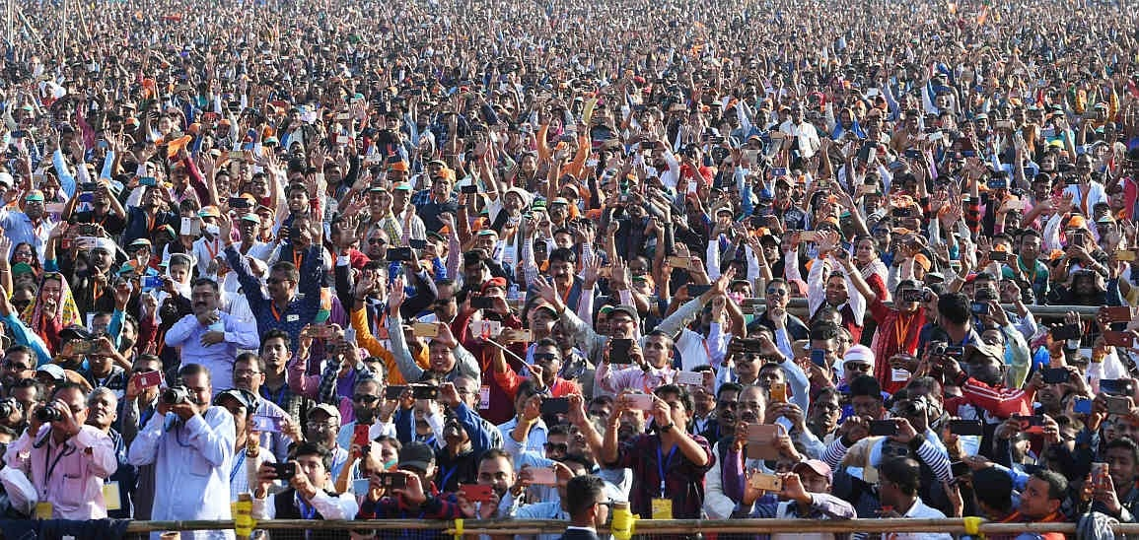
Who can we sell to?

Slide 28
What skills have you used?

